Slide 1
Micro Credit Loan Defaulter Project

Slide 2
Problem Statement
To predict the micro credit loan defaulter.
The data for this project was provided by the client company.

Slide 3
Background
Today, microfinance is widely accepted as a poverty-reduction tool, representing $70 billion in outstanding loans and a global outreach of 200 million clients.
Our client is collaborating with an MFI to provide micro-credit on mobile balances to be paid back in 5 days.
In order to improve the selection of customers for the credit, the client wants some predictions that could help them in further investment and improvement in selection of customers.

Slide 4
EDA Procedure
First step is to get insight of the dataset by determining the shape of data and finding the data type.
Next we perform null value analysis, since no null value is detected, we move to next step.
The pdate column containing date of loan as data is extracted into three newly created column as day, month, year. Later this pdate column is dropped.

Slide 5
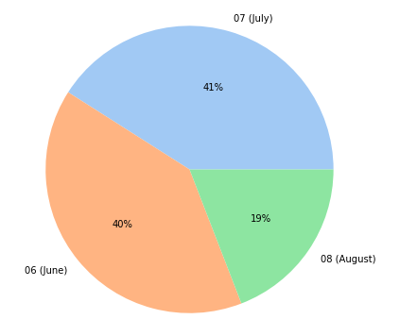
Since registered mobile number has to be unique for each account, the duplicate values detected in msisdn column are dropped.
Using visualization techniques we perform univariate, bivariate analysis.
Percentage distribution of customers who have taken loan in each month

Slide 6
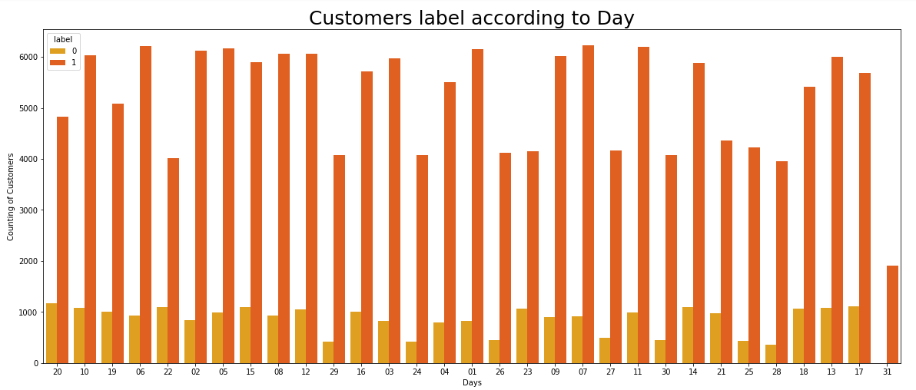
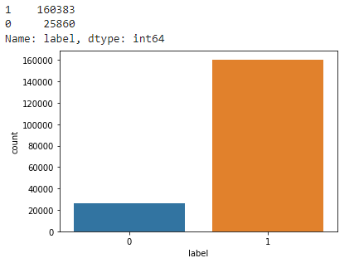
There are 25860 customers who haven’t paid loan yet.
160383 customers have paid the loan.
Customer distribution across days of all 3 months combined.
7th day of every month, there are highest number of
customers who pay their loan.

Slide 7
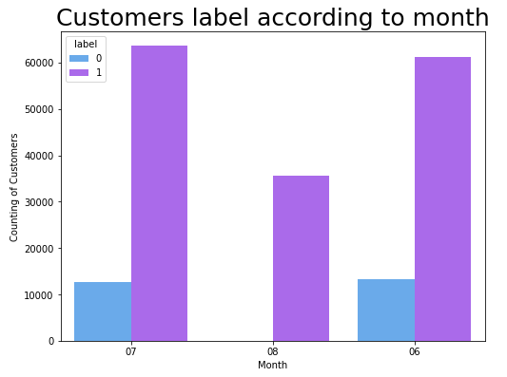
There are no customers left in defaulter list by august 2016.
Majority of customers have paid their loan in month of July.

Slide 8
During Outliers analysis it is found that multiple features contain high amount of outlier. Since the data loss after removing outliers is more than 20%, we avoid removing outliers altogether.
Also, simply removing all outliers might affect our models incase outliers were present in the test dataset.
Next we handle skewness using quantile tranformation.
we split the dataset into input and target features. We drop year column we initially created along with pcircle column since they contribute only one value.
Categorical features are then encoded using the label encoder

Slide 9
Since the data distribution is not gaussian, Min-Max normalization is performed to rescale data between 0 and 1.
Further, the train_test split is performed with 20% data reserved for test set and 80% for train set.
We test dataset using different model to find best fit model.
Model with least log loss is saved.

Slide 10
Conclusion
In this study we found that random forest classifier algorithm performs slightly better than random regression and rest of the algorithm tested.
cnt_ma_rech30, cnt_ma_rech90, sumamnt_ma_rech30, sumamnt_ma_rech90, amnt_loans_30, amnt_loans_90, cnt_loans30, daily_decr30, daily_decr90 are the top features of the micro credit loan that highly impact the defaulter list among all the features in the dataset.

